Slide 1
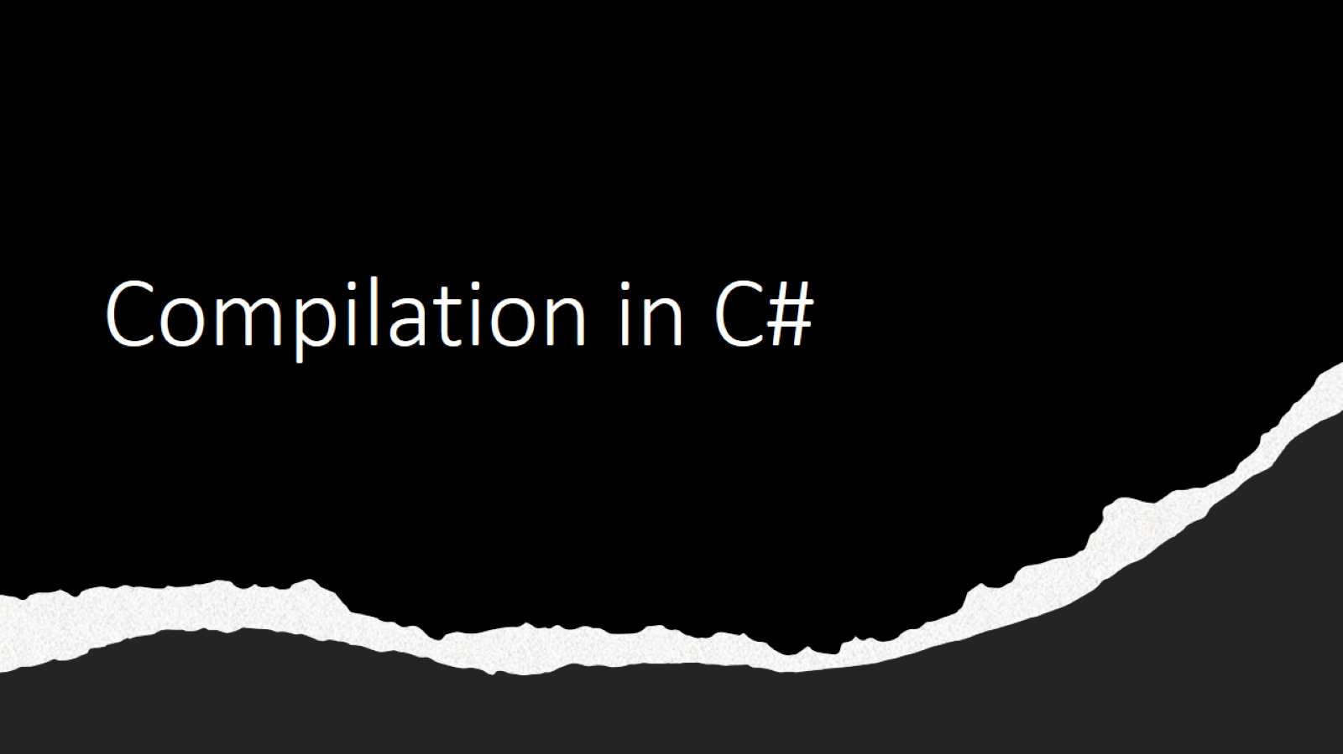
Compilation in C#

Slide 2
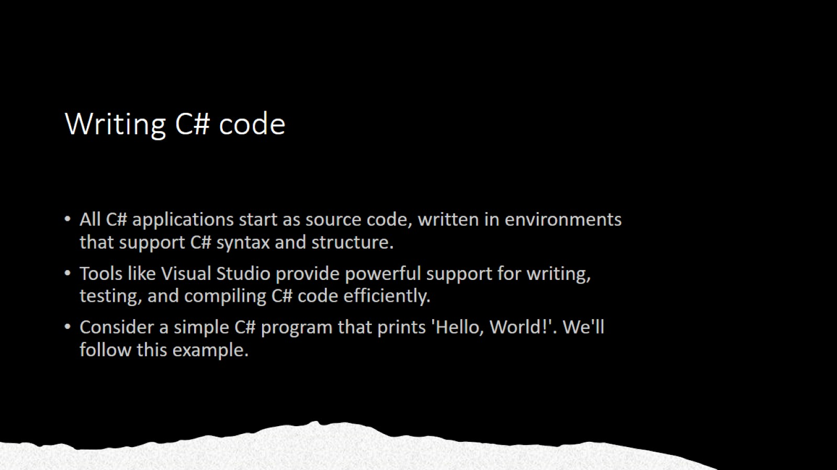
Writing C# code

Slide 3
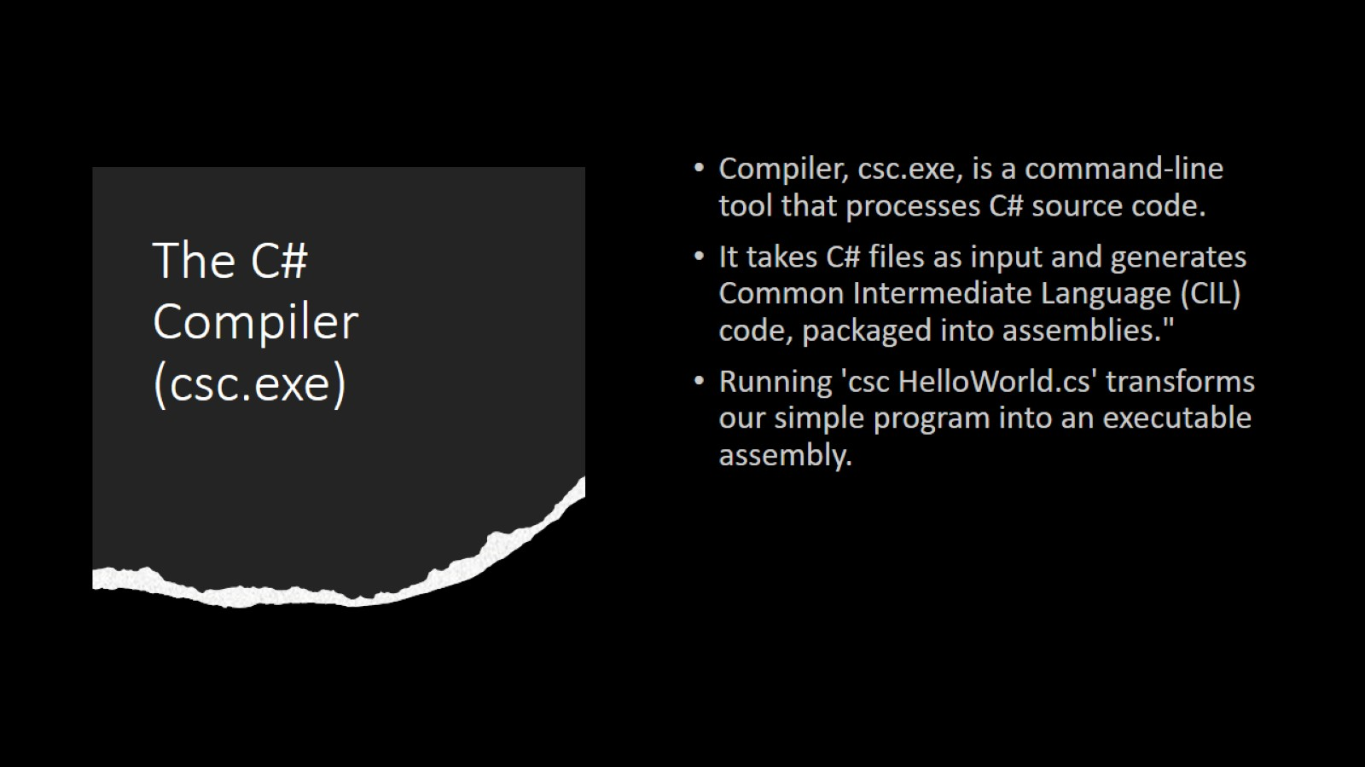
The C# Compiler (csc.exe)

Slide 4
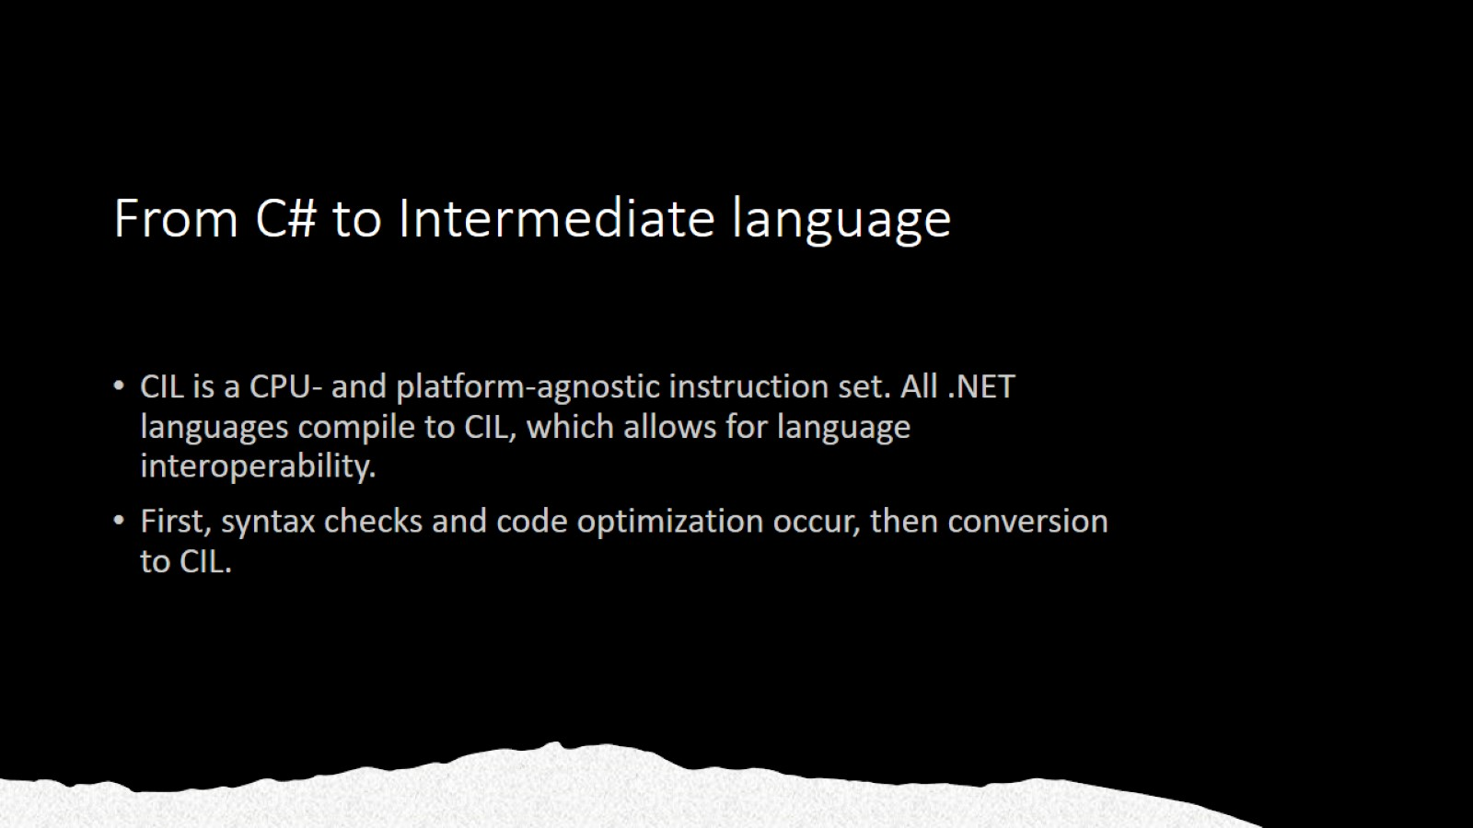
From C# to Intermediate language

Slide 5
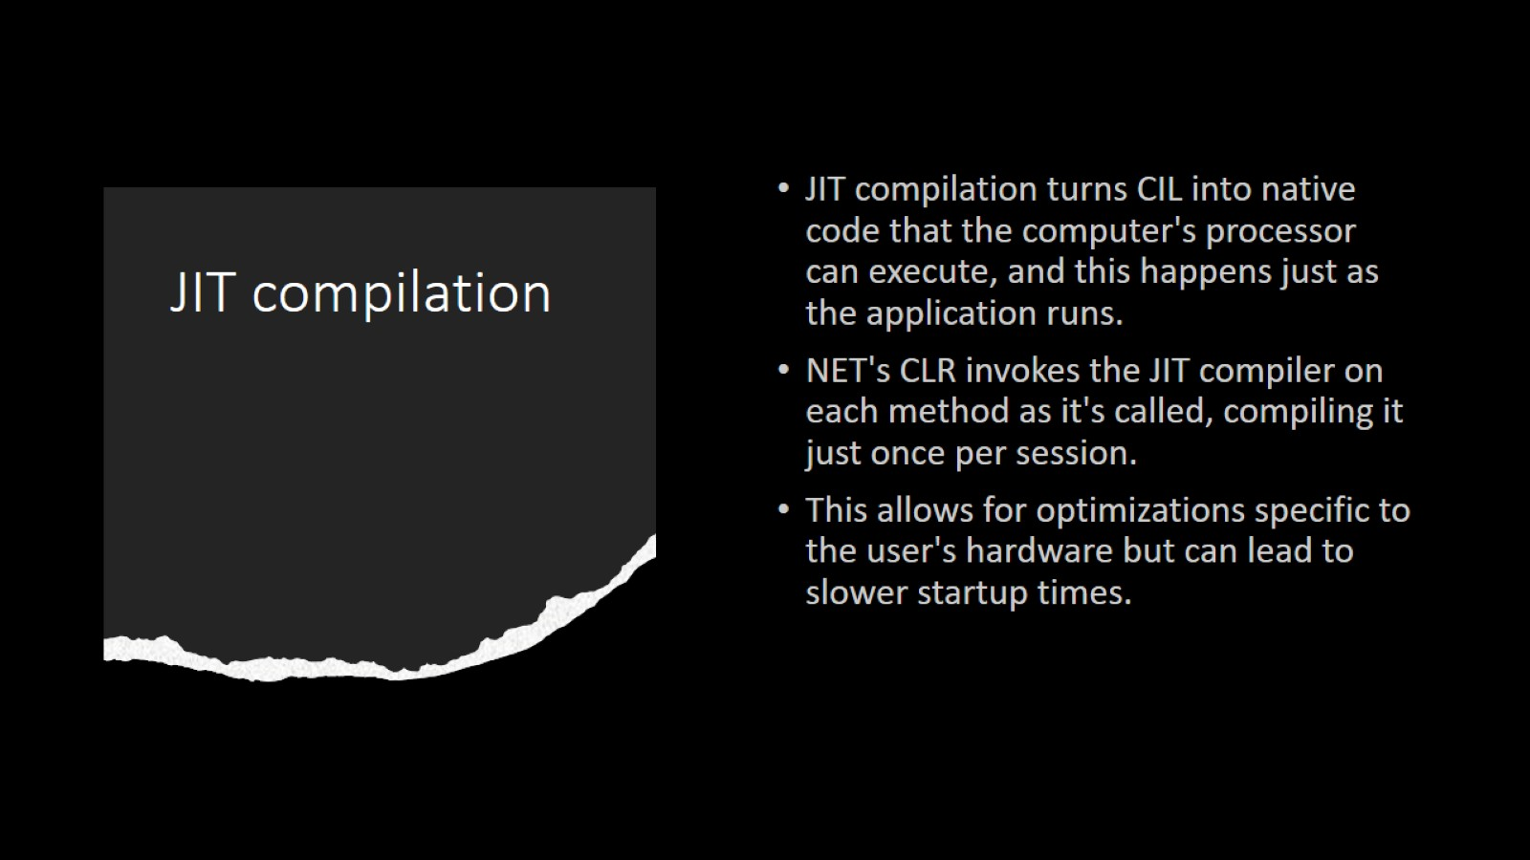
JIT compilation

Slide 6
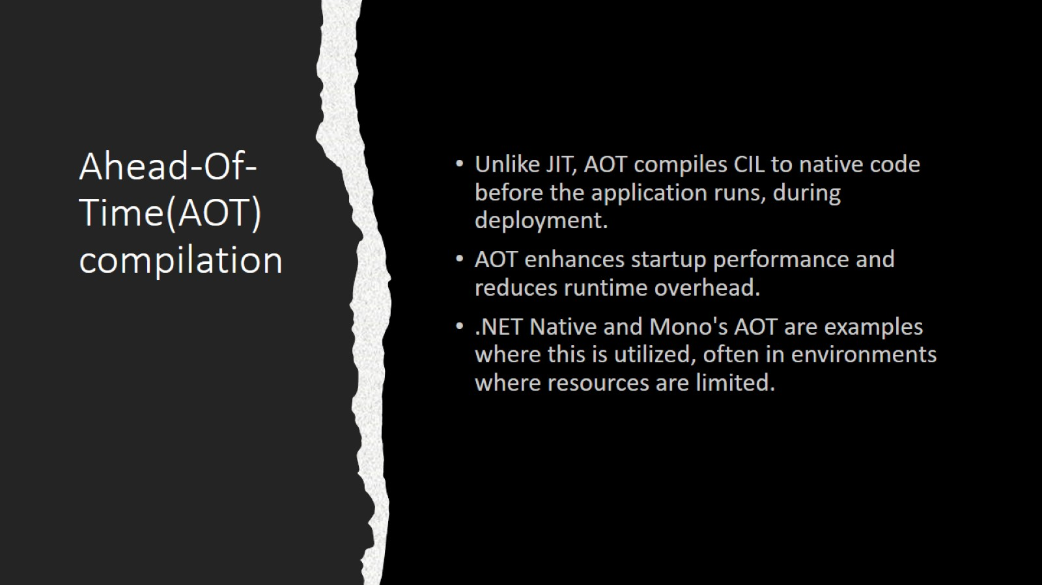
Ahead-Of-Time(AOT) compilation

Slide 7
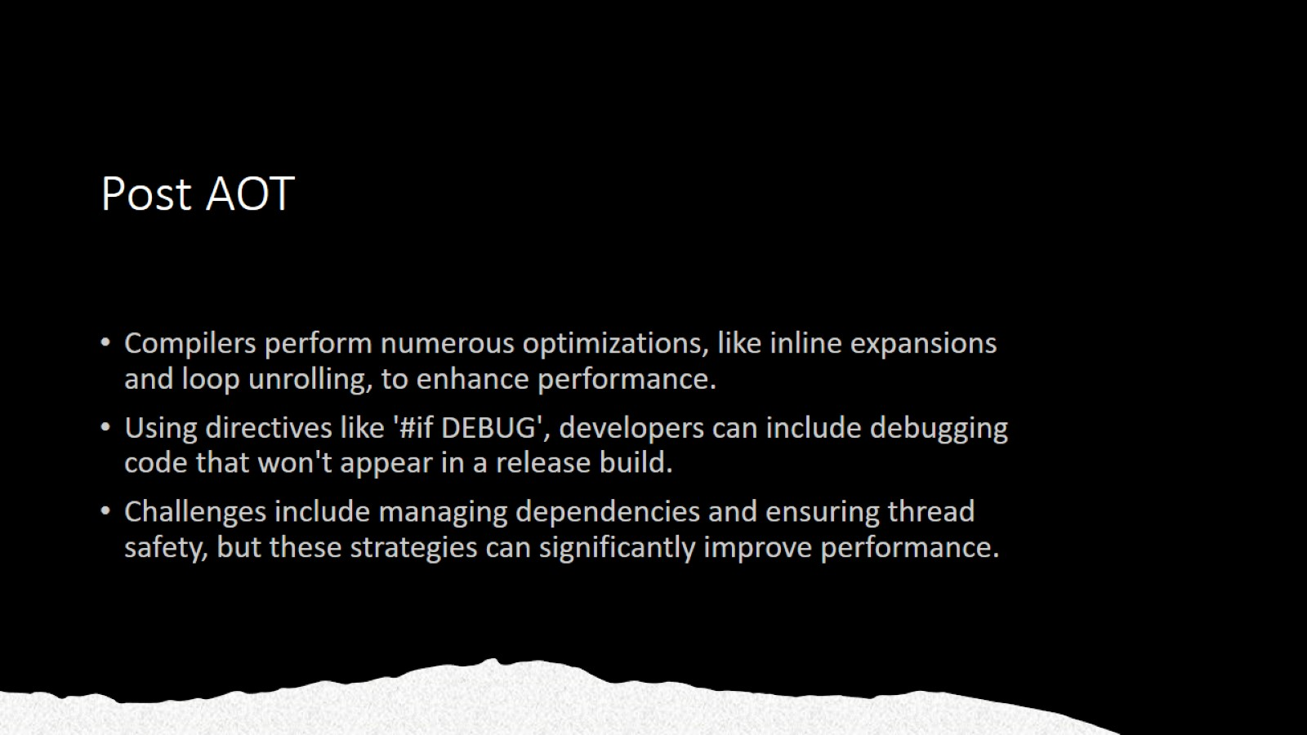
Post AOT

